Slide 1
FEQHA European Youth & Amateur Team Cup
CURRENT STATUS – MARCH 2024

Slide 2
European Team Cup 2024
19.-21. July 2024
Kumlegaard QH, Roskilde, Denmark
Two AQHA-approved judges - Rick Lemay & David Avery
Professional photographer and livestream
Friendly staff
Free Saturday night barbecue
”Stall decoration” competition and other fun competitions

Slide 3
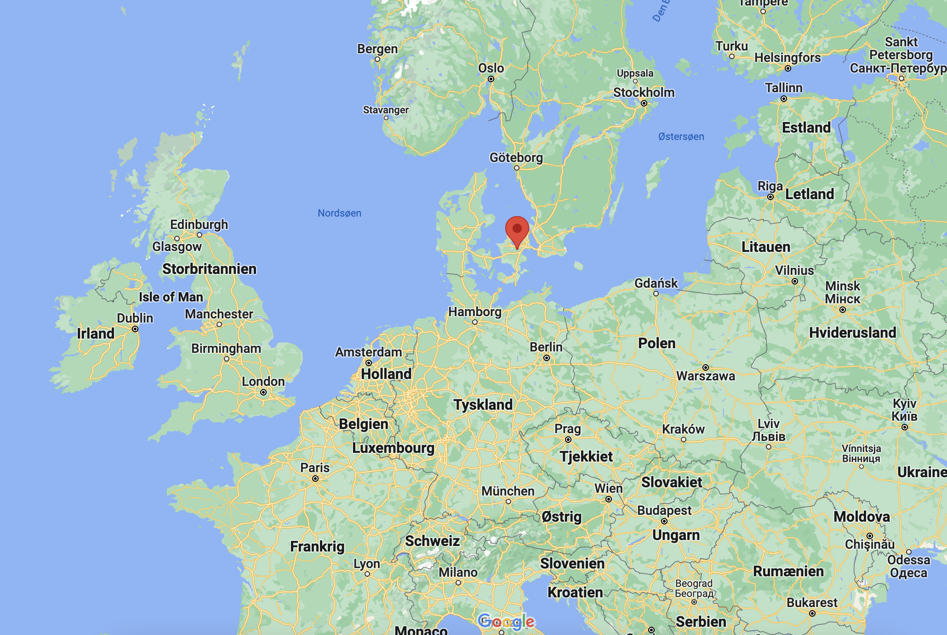
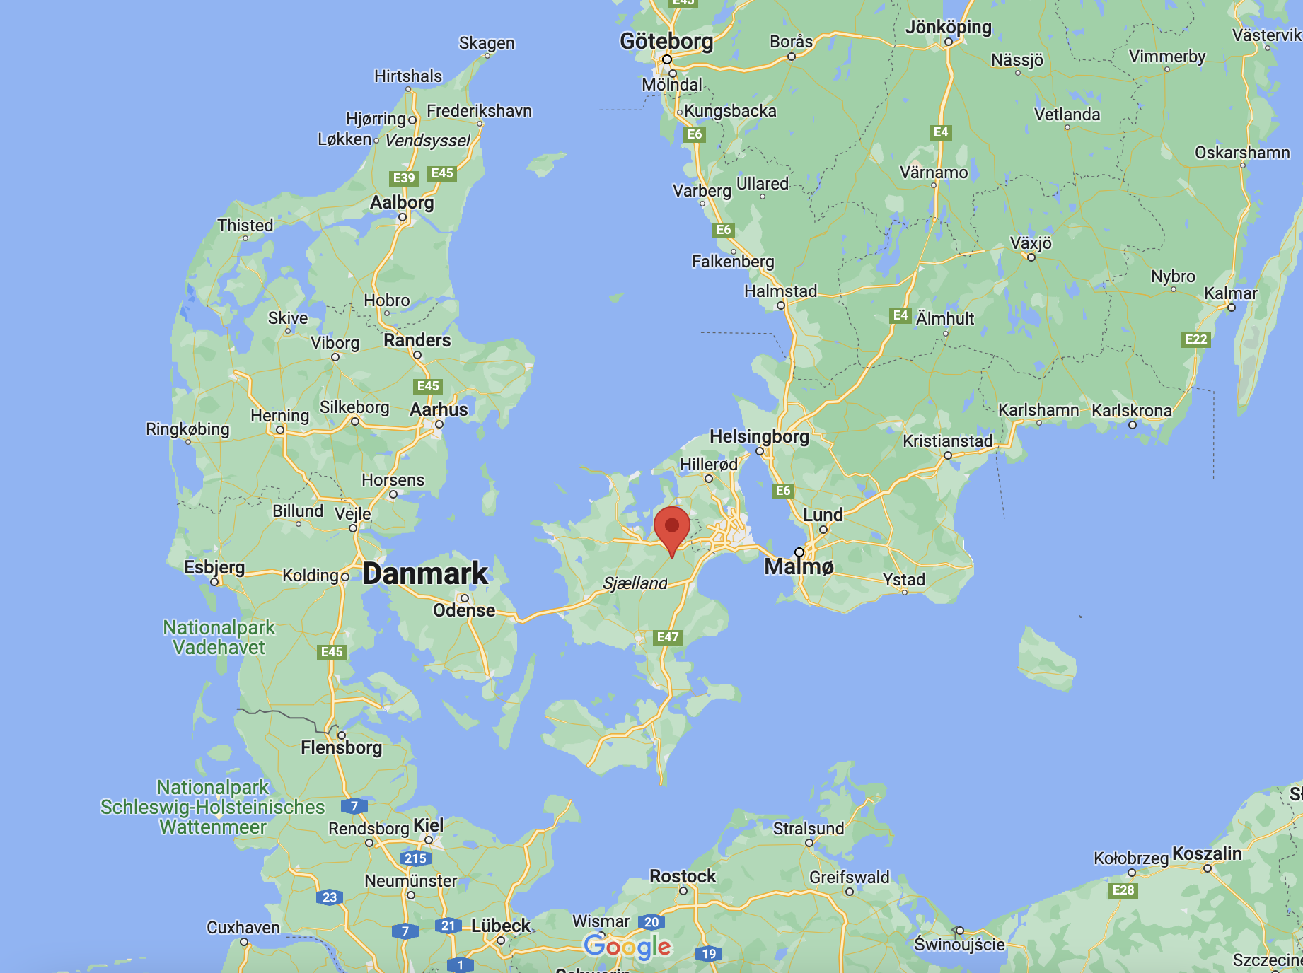
European Team Cup 2024
Transport to Denmark
The Team Cup will take place at Kumlegaard QH in Roskilde, Denmark. The address is ”Kumlehusvej 2, 4000 Roskilde, Denmark”. Only 35 minutes drive from Copenhagen

Slide 4
European Team Cup 2024
Transport to Denmark
The Team Cup will take place at Kumlegaard QH in Roskilde, Denmark. The address is ”Kumlehusvej 2, 4000 Roskilde, Denmark”.
You can either drive to the german/danish boarder and drive to Kumlegaard by bridges, or you can drive to Puttgarden, Germany or Rostock, Germany and take the ferry to Denmark. The ferry is a comfortable choice for horses and often used by Danish riders.
Driving distance from different cities in Europe
Berlin-Kumlegaard (by ferry): 6 hours, 20 minutes
Kreuth-Kumlegaard (by ferry): 10 hours, 20 minutes
Amsterdam-Kumlegaard (by ferry or bridge): 9 hours, 30 minutes
Zürick-Kumlegaard (by ferry): 13 hours, 30 minutes
Stockholm-Kumlegaard (by bridge): 7 hours, 15 minutes

Slide 5
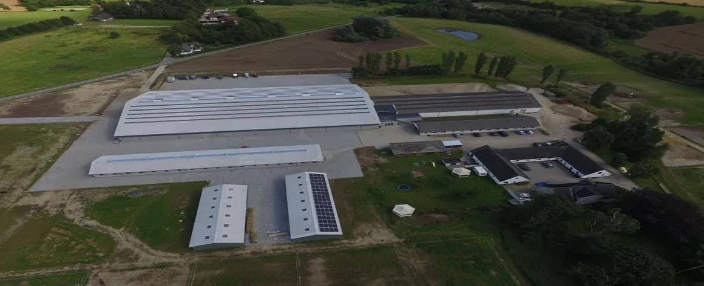
European Team Cup 2024
The facility
Kumlegaard was renovated and build in 2017. It is a modern western facility and are the host of multiple AQHA and NRHA shows every year. At Kumlegaard you find the following facilities:
Show arena (40 x 80 meters, seats for 800 spectators. Suitable for reining
Indoor warm up arena (20 x 52 meters). Build in connection with the show arena. Suitable for reining.
Outdoor fenced arena (30 x 60 meters). Not suitable for reining
80 indoor boxes and plenty of space for tent barns
Large grass area for camping
Modern cafeteria
Spa for horses (requires additional payment)

Slide 6
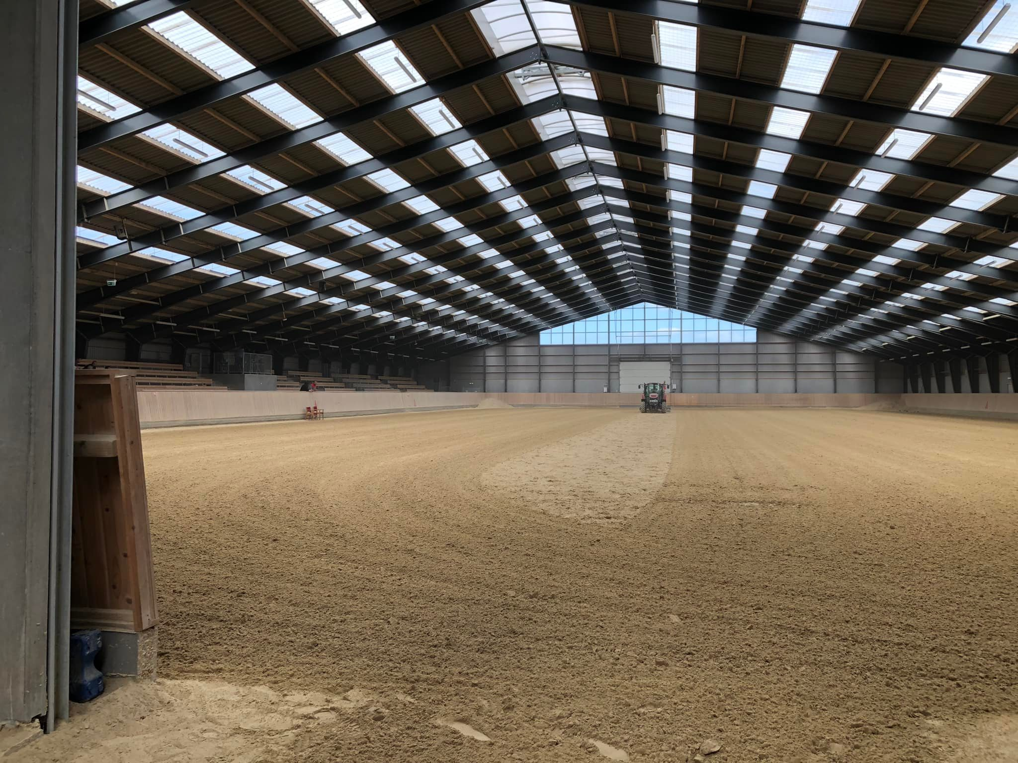

Slide 7
European Team Cup 2024
Official logo

Slide 8
European Team Cup 2024
Disciplines
Showmanship at halter (3)
Hunter u saddle (3)
Hunt seat equitation (3)
Western pleasure (3)
Western horsemanship (3)
Trail (3)
Ranch riding (3)
Reining (2)
Ranch trail (2)

Slide 9
European Team Cup 2024
ALL OFFICIAL DOCUMENTS ARE ON WWW.DKQHA.DK
FIRST DEADLINE 15.04.2024
SECOND DEADLINE 20.06.2024

Slide 10
European Team Cup 2024
Very resonable prices!! - €2000 pr. team of 5 riders (same price as in 2015) - Includes 5 stalls, 1 tack box, entry fees all other show fees - Additional costs: Individual riders, camping, food, entry fee for Friday show

Slide 11
European Team Cup 2024
Coffee mug with Team Cup logo for all participants - Sponsored by Kumlegaard
Medals and ribbon bands in classes
Belt buckles for winning teams sponsored by CR Saddles
RB Leather Collection – leather halters with engraving for Reserve Champion teams
RB Leather Collection bracelet with engraving for 3rd place teams - Sponsored by RB Leather Works

Slide 12
European Team Cup 2024
Friday
AQHA 2-judge show - Youth, L1 Amateur, Open - Same classes as the European Team Cup - Open for everyone - Opening Ceremony

Slide 13
European Team Cup 2024
Remember that countries might join to create a team, if they do not have enough riders to form a team.

Slide 14
European Team Cup 2024
Current status: - Denmark: 1 youth + 1 amateur team - Germany: 1 youth + 2 amateur teams - Belgium: 1 youth + 1 amateur team
- Switzerland: 1 youth (maybe 1 amateur team) - Norway, UK, Netherlands: No teams - Might be possible to borrow 1-3 horses locally from Natasha Møller/Kumlegaard

Slide 15
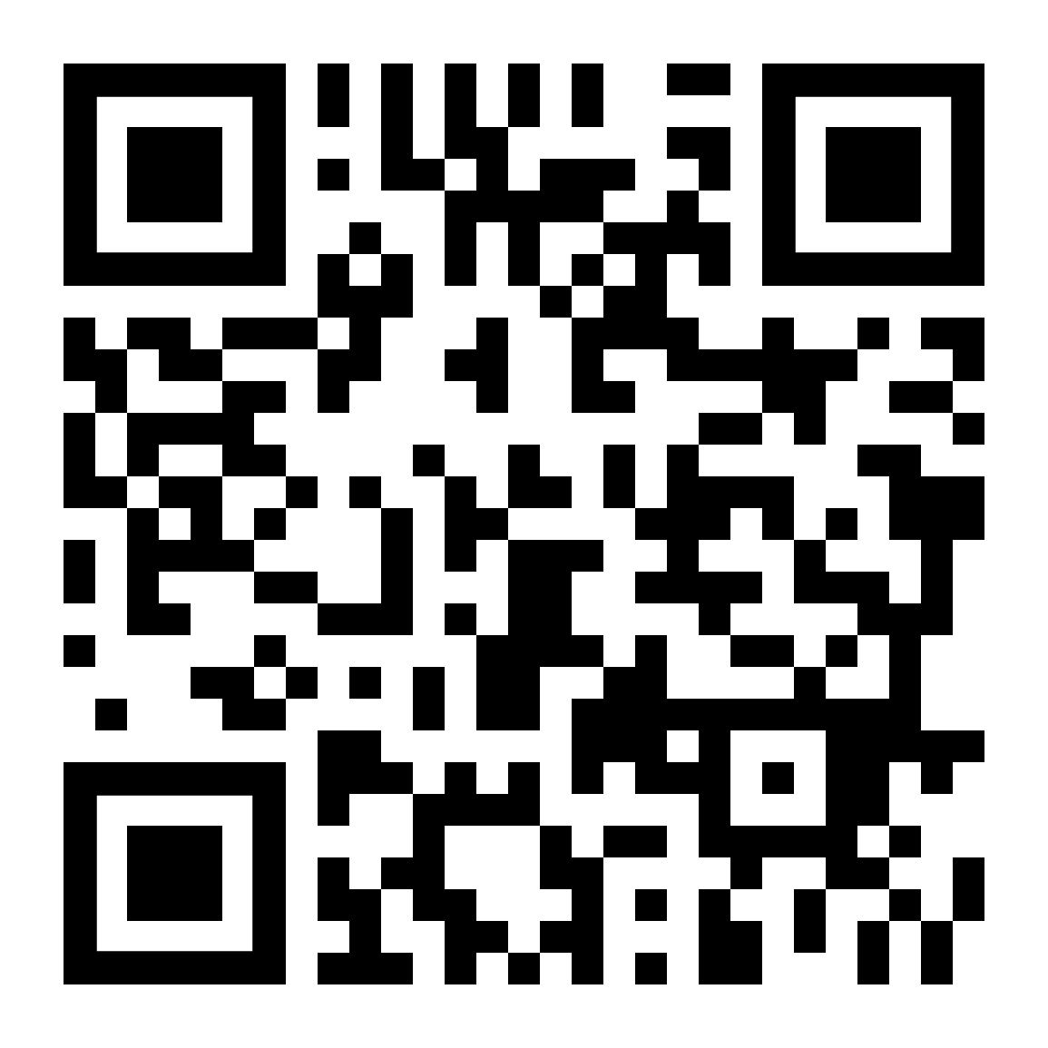
European Team Cup 2024
QUESTIONS?

