Slide 1
FEQHA European Youth & Amateur Team Cup
CURRENT STATUS – NOVEMBER 2023

Slide 2
European Team Cup 2024
19.-21. July 2024
Kumlegaard QH, Roskilde, Denmark
Two AQHA-approved judges - Rick Lemay & David Avery
Professional photographer and livestream
Friendly staff
Free Saturday night barbecue
”Stall decoration” competition and other fun competitions

Slide 3
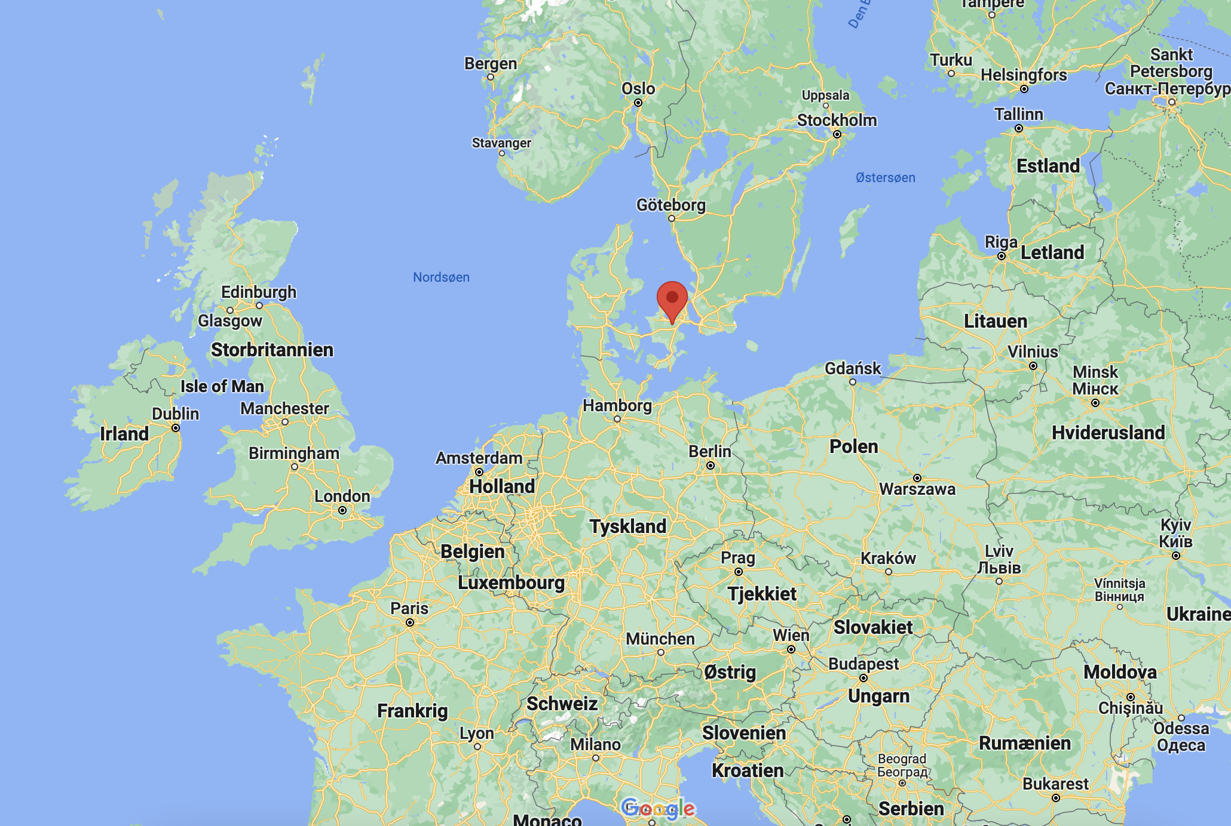
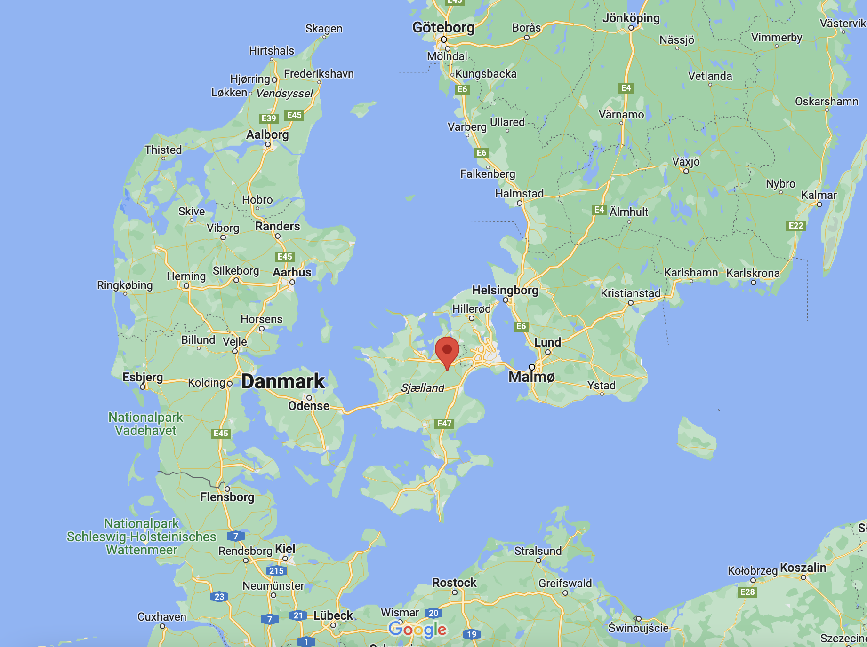
European Team Cup 2024
Transport to Denmark
The Team Cup will take place at Kumlegaard QH in Roskilde, Denmark. The address is ”Kumlehusvej 2, 4000 Roskilde, Denmark”. Only 35 minutes drive from Copenhagen

Slide 4
European Team Cup 2024
Transport to Denmark
The Team Cup will take place at Kumlegaard QH in Roskilde, Denmark. The address is ”Kumlehusvej 2, 4000 Roskilde, Denmark”.
You can either drive to the german/danish boarder and drive to Kumlegaard by bridges, or you can drive to Puttgarden, Germany or Rostock, Germany and take the ferry to Denmark. The ferry is a comfortable choice for horses and often used by Danish riders.
Driving distance from different cities in Europe
Berlin-Kumlegaard (by ferry): 6 hours, 20 minutes
Kreuth-Kumlegaard (by ferry): 10 hours, 20 minutes
Amsterdam-Kumlegaard (by ferry or bridge): 9 hours, 30 minutes
Zürick-Kumlegaard (by ferry): 13 hours, 30 minutes
Stockholm-Kumlegaard (by bridge): 7 hours, 15 minutes

Slide 5
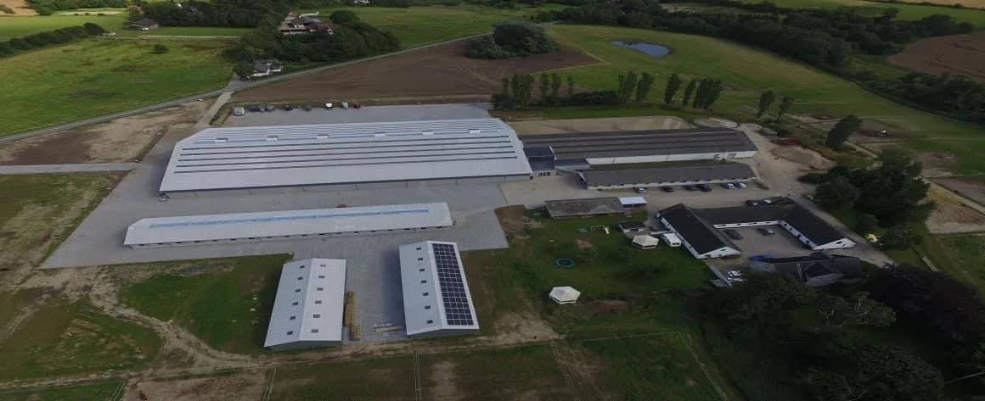
European Team Cup 2024
The facility
Kumlegaard was renovated and build in 2017. It is a modern western facility and are the host of multiple AQHA and NRHA shows every year. At Kumlegaard you find the following facilities:
Show arena (40 x 80 meters, seats for 800 spectators. Suitable for reining
Indoor warm up arena (20 x 52 meters). Build in connection with the show arena. Suitable for reining.
Outdoor fenced arena (30 x 60 meters). Not suitable for reining
80 indoor boxes and plenty of space for tent barns
Large grass area for camping
Modern cafeteria
Spa for horses (requires additional payment)

Slide 6
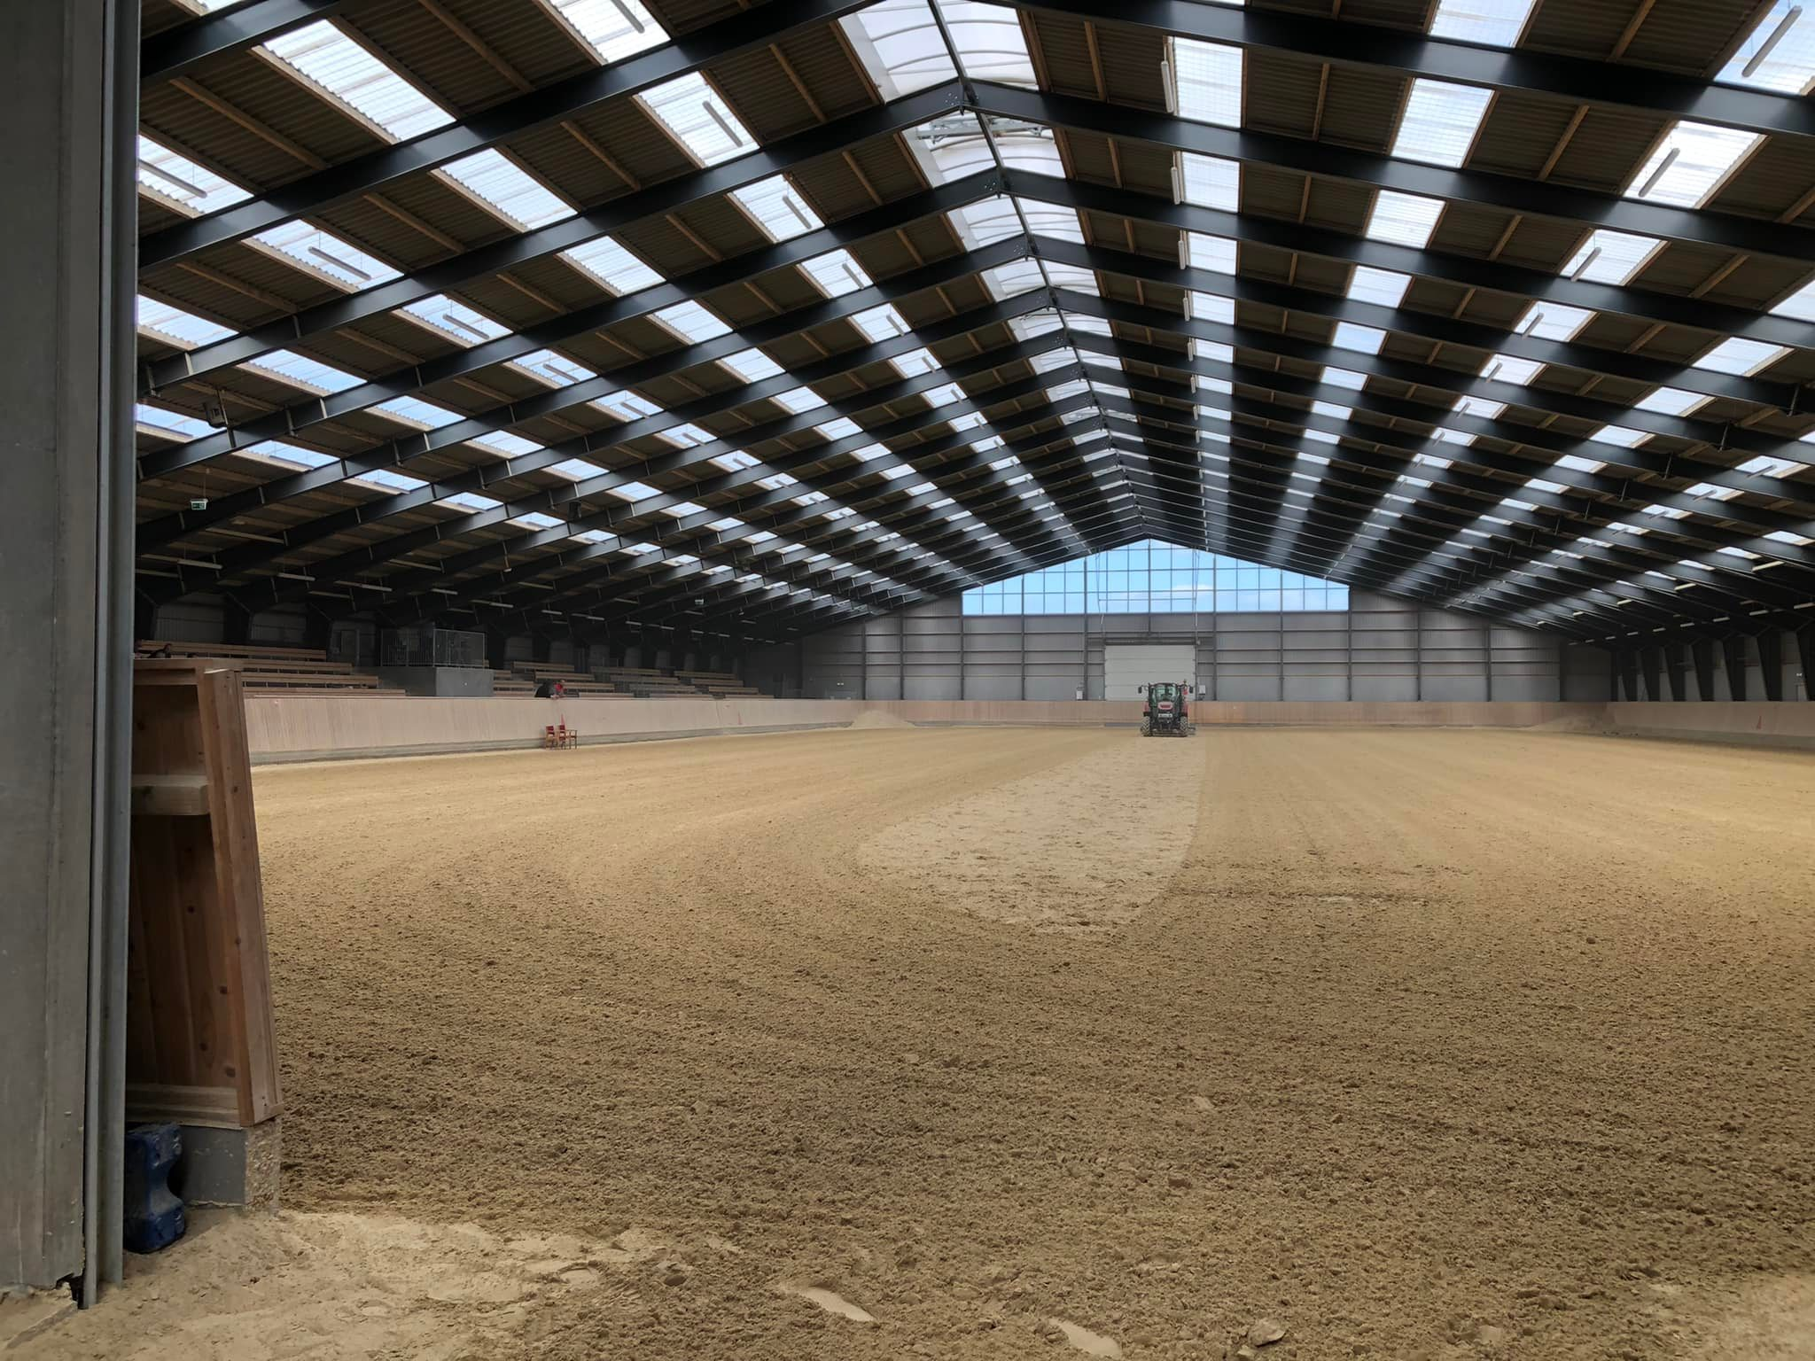

Slide 7
European Team Cup 2024
Official logo

Slide 8
European Team Cup 2024
Disciplines
Showmanship at halter (3)
Hunter u saddle (3)
Hunt seat equitation (3)
Western pleasure (3)
Western horsemanship (3)
Trail (3)
Ranch riding (3)
Reining (2)
Ranch trail (2)

Slide 9
European Team Cup 2024
Very resonable prices!! - €2000 pr. team of 5 riders (same price as in 2015) - Includes 5 stalls, 1 tack box, entry fees all other show fees - Additional costs: Individual riders, camping, food, entry fee for Friday show

Slide 10
European Team Cup 2024
Coffee mug with Team Cup logo for all participants - Sponsored by Kumlegaard
Medals and ribbon bands in classes
Belt buckles for winning teams
RB Leather Collection – leather halters with engraving for Reserve Champion teams
RB Leather Collection bracelet with engraving for 3rd place teams - Sponsored by RB Leather Works

Slide 11
European Team Cup 2024
Friday
AQHA 2-judge show - Youth, L1 Amateur, Open - Same classes as the European Team Cup - Open for everyone - Opening Ceremony

Slide 12
European Team Cup 2024
Most important rules
Each National Team will consist out of minimum 3 (three) and maximum 5 (five) team members.
Each Affiliate will be allowed to bring at least one team per category (Youth & Amateur), from 3 to 5 riders and horses.
Each country will be allowed to delegate two additional individual Youth or Amateur participants. Their results will only be included in the individual standings.
If there are countries that do not present a complete Team, they may combine their individual riders to form a Team with other individual riders.
The horses do not have to be owned by the team member(s).
Each horse is only allowed to participate in the same class once

Slide 13
European Team Cup 2024
QUESTIONS?

